Slide 1
Dunstan School – before the memories
Founded when?

Slide 2
Types of Evidence
Anecdotal
Memories – can only go back to around the 1920’s
Hearsay – memories told by others, for example, “grandparents”
Documentary
Primary – deeds, wills, registers, census, contracts, maps, legislation, log books, minutes, parish records, plans
Secondary – newspapers, books, correspondence

Slide 3
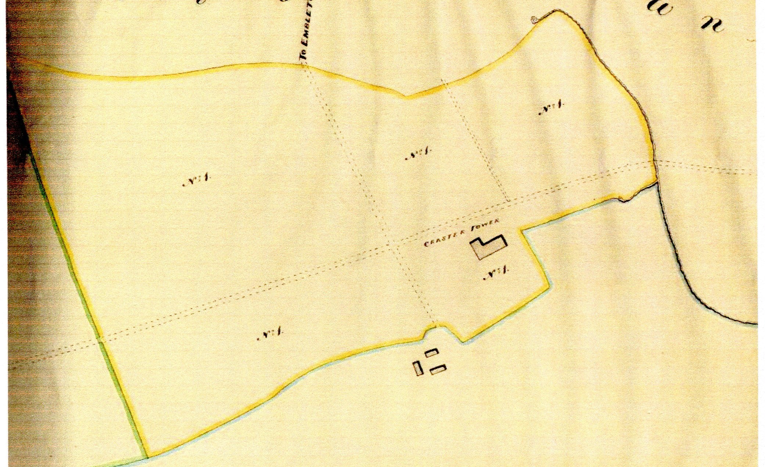
1842 –Tithe Award Plan

Slide 4
Charity Commission Report 1819 – 1837
A survey into charities in England and Wales and in the section on Northumberland it mentions schools in Howick (1749) and Lesbury (1718), but no mention of Dunstan or Craster

Slide 5
Dunstan – 1851 Census

Slide 6
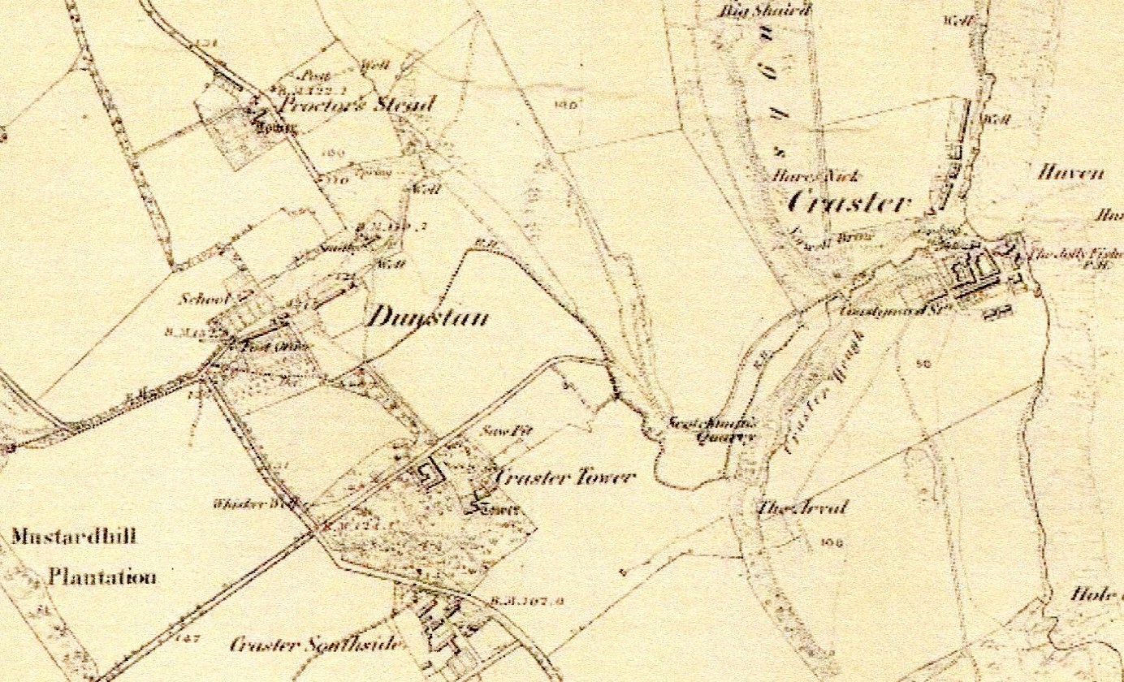
C 1860 First Edition OS Map

Slide 7
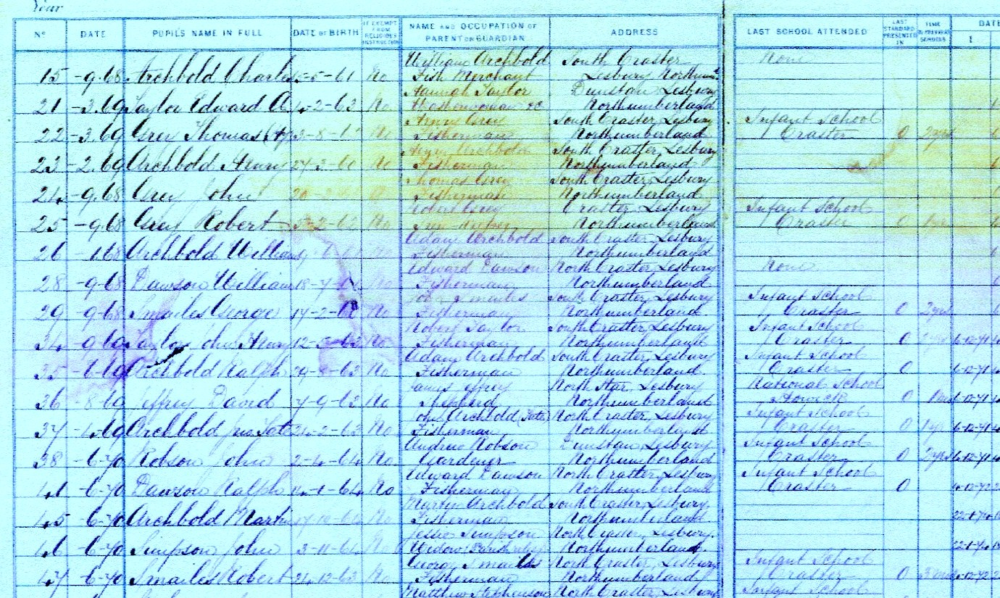
Admissions Register - 1868

Slide 8
Schools in Craster
Butcher’s Shop
Anecdotal evidence of a school in Winn Hill
Memorial Hall
Drawings of memorial hall in the Craster papers give it the title “Craster School”

Slide 9
School Log Book - 1876

Slide 10
Attendance in 1878/9
Outbreak of diphtheria and Scarlet Fever
Date Attendance
25th Oct 25 Over 40 children absent
4th Dec 22
11th Dec 20
13th Dec 19
29th Dec 17
13th Jan Margaret Archbold died with Scarlet fever
22nd Jan Another death ...............

Slide 11
Closed School File 5450/36
The school appears to have been built about 1825.
The LEA does not hold the deeds. Owned by JW Craster and leased for 1/- pa.
Teacher’s house rented by LEA for £18/12/0 pa

Slide 12
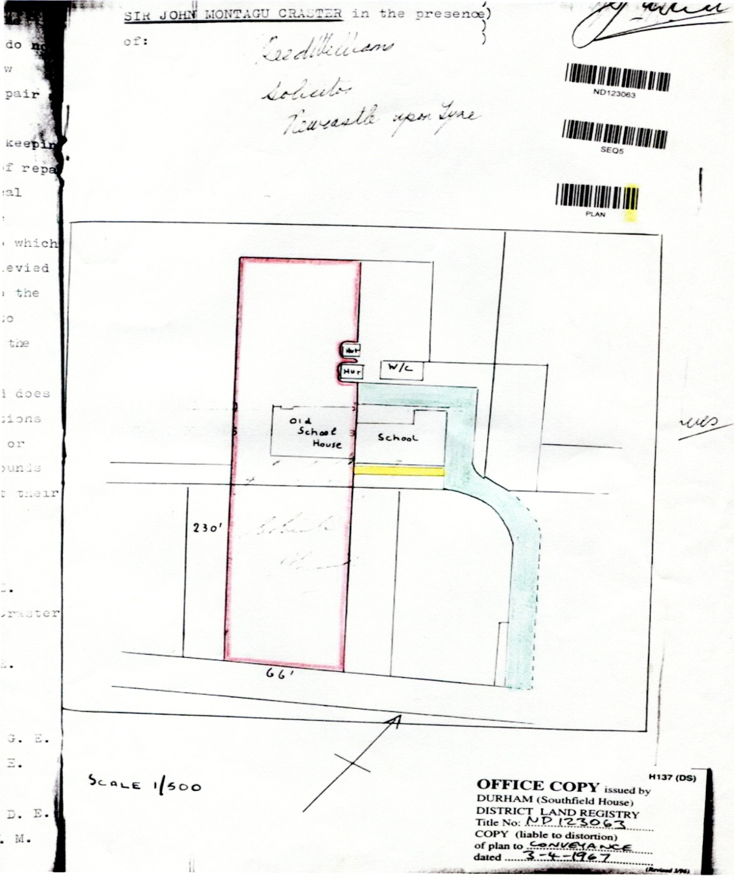
Deeds of the School
The deeds of the school
are dated 1967.
This is because prior to
that date the school
was part of the Craster
Estate.
The extension to the
school in 1912 was done by
the Craster family.

Slide 13
Shaftoe Craster’s Foundation
Indenture 13/12/1825
Made a charge on Spittleford Farm of £30 pa for education of 25 poor children (13 boys and 12 girls) at the existing Dunstan School.
Education only in arithmetic, penmanship, reading and English grammar.

Slide 14
Shaftoe Craster’s Foundation
Between 11/9/1903 and 16/5/1904 correspondence between Board of Education, LEA and Thomas Wood Craster.
TWC claimed that as Shaftoe was tenant for life of the farm the deed was illegal.
This was finally confirmed by an examination of the will of Shaftoe’s father, Sir John Craster.

Slide 15
Dunstan School – before the memories
Founded when?

Slide 17
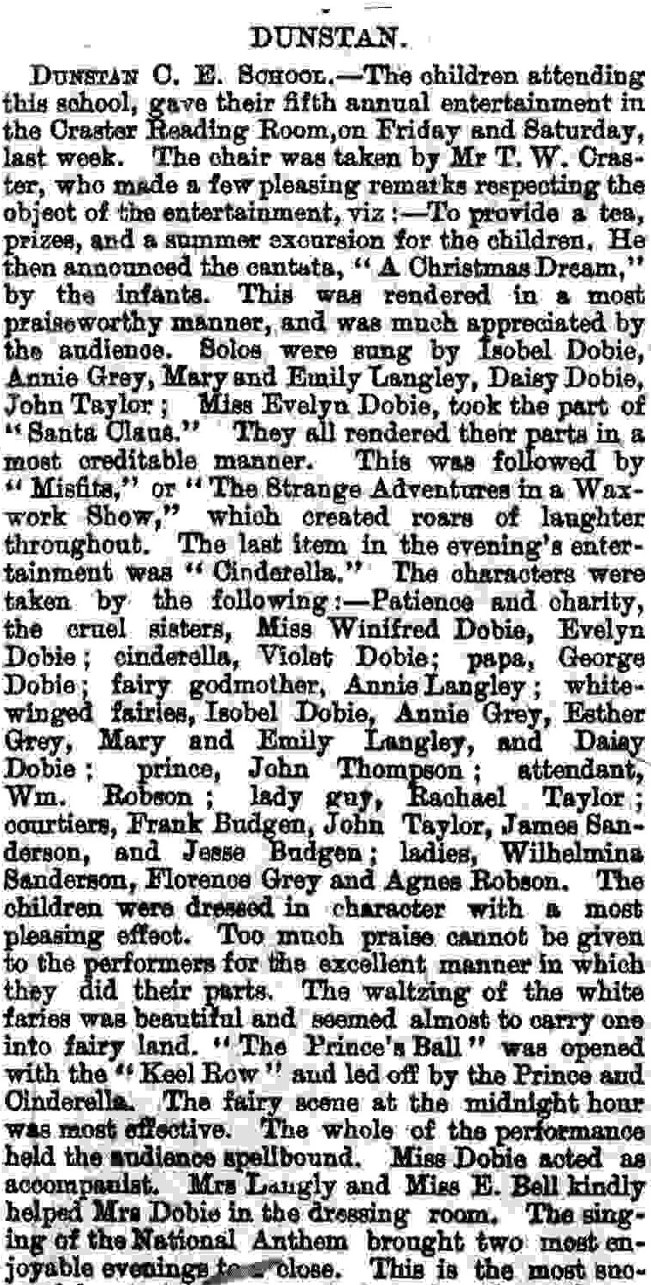
Alnwick Mercury Jan 12th 1901

Slide 18
Education Legislation
1834 – Poor law schools established
1870 – School Boards
1902 – Established Local Education Authorities and The Board of Education

Slide 19
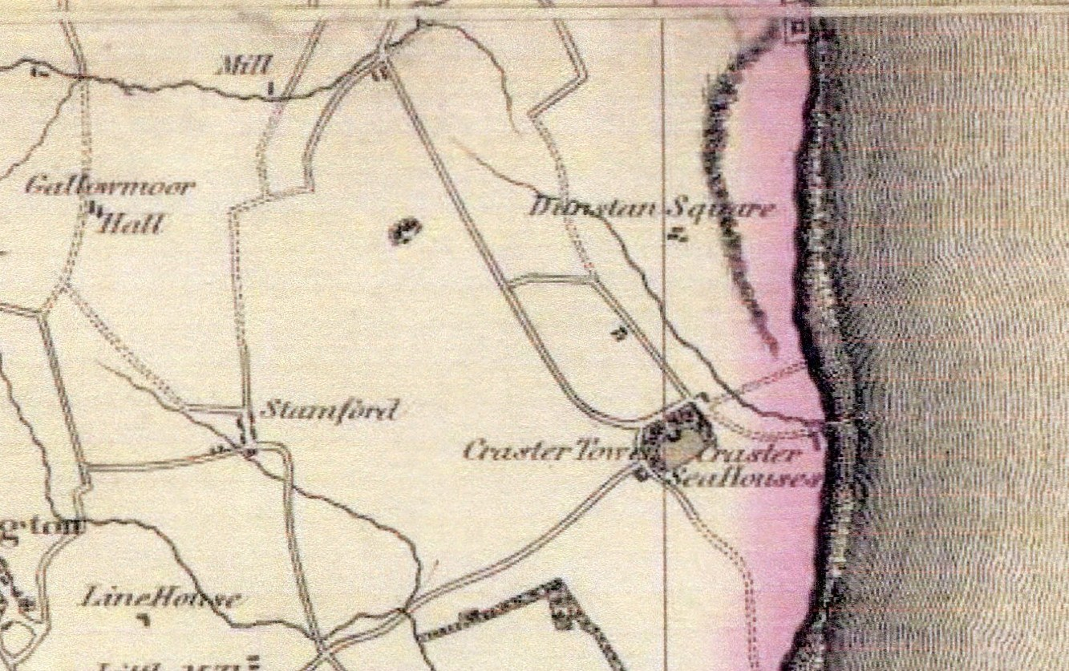
1820 – Fryer’s Map

Slide 20
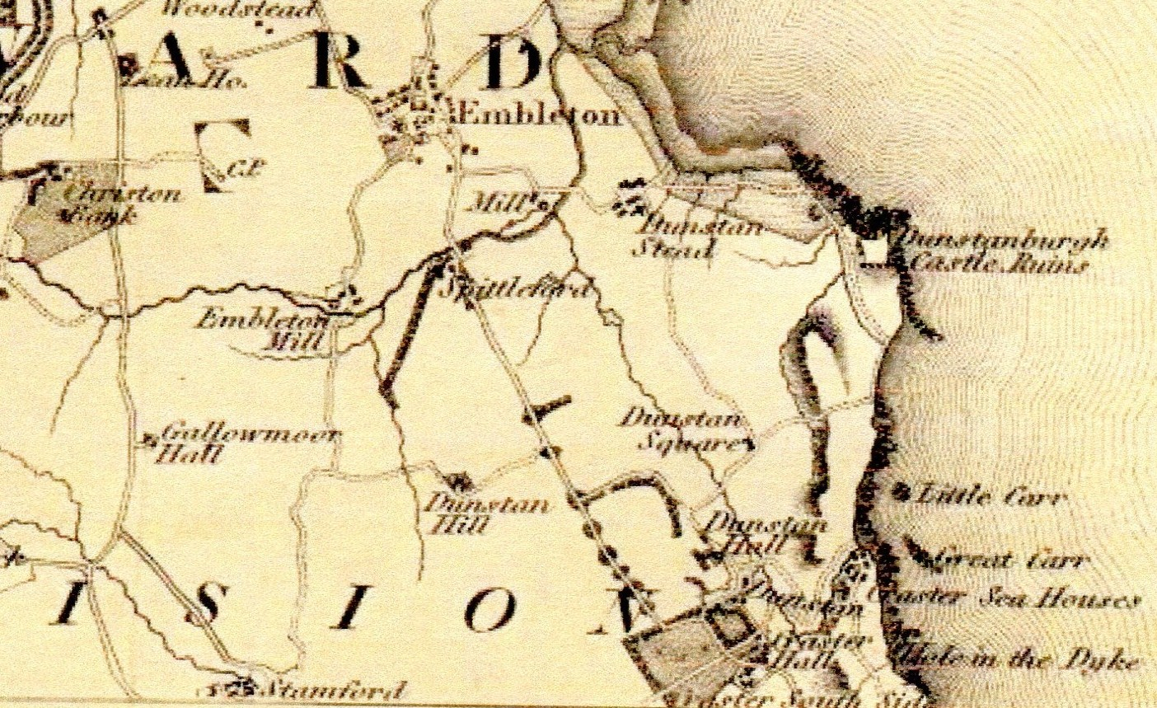
1828 – Greenwood’s Map

